Slide 1
Network Paradigms​ (Continued)

Slide 2
Part I Syllabus
Week​​ | Date​​ | Subject​​
Week 1​ ​ | 9/Jan/2023​​ | Introduction: Course Logistics and Internet History​​
 | 11/Jan/2023​​ | Layered Network Architecture​​
Week 2​ | 16/Jan/2023​​ | Physical-layer Resilience​
 | 18/Jan/2023​​ | Data Link Layer: Flow Control​​
Week 3​ | 25/Jan/2023​​ (no class on 23/Jan/2023, a holiday​)​ | Data Link Layer: Error Control​​
Week 4​ | 30/Jan/2023​​ | Local Area Network: Introduction​​
 | 01/Feb/2023​​ | Local Area Network: Medium Access Control (MAC)​​
Week 5​ | 06/Feb/2023​​ | Local Area Network: Ethernet​​
 | 08/Feb/2023​​ | Local Area Network: Ethernet Evolutions​​
Week 6​ | 13/Feb/2023​​ | Wireless Local Area Network (WLAN): Overview and 802.11​
 | 15/Feb/2023​​ | First Part: WLAN’s Multi-Access Reservation Protocol (MARP);​ Second Part: A Brief Overview of Network Paradigms​​
Week 7​ | ​20/Feb/2023 | ​Network Paradigms​​
 | 22/Feb/2023​ | Network Paradigms​ (Continued) and Mobile Access Networks​

Slide 3
Delay Analysis

Slide 4
Delay in Packet Switching Networks
Propagation Delay
Transmission Delay
}
Processing + Queueing Delay
Time
Link
Link
Node
S
Node
I
Node
D

Slide 5
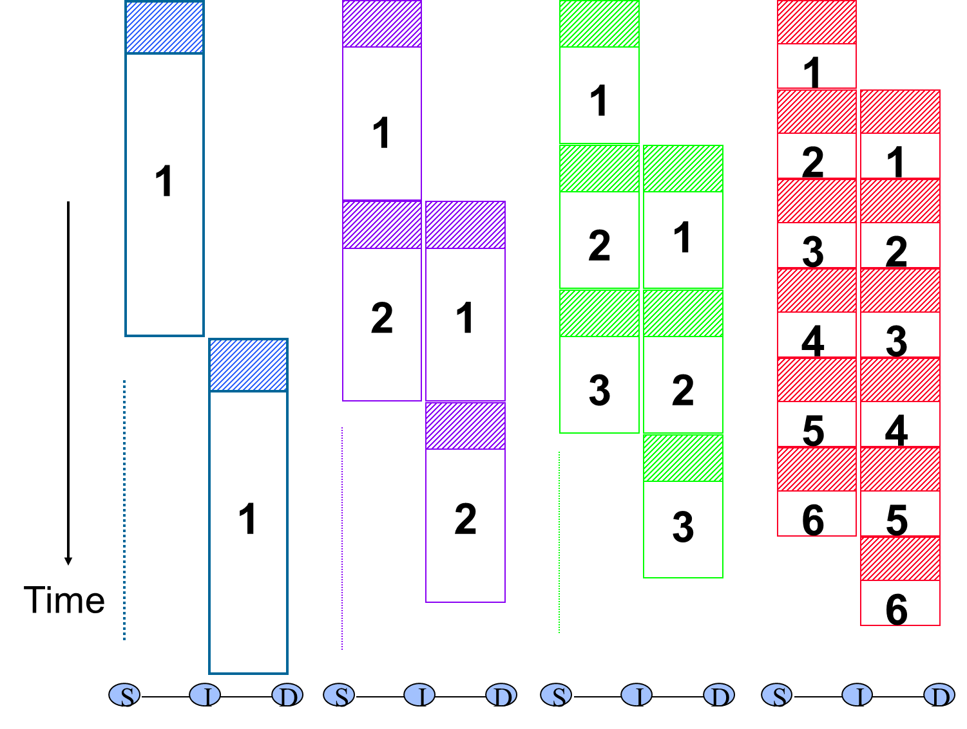
Pipeline Effect

Slide 6
Packet Transmission Delay: Overhead vs. Pipeline
Example:
3 hops & 4 nodes
∴Tx delay = 4 T_{frame} + (3-1) T_{frame}
In general:
Tx Delay of Packet Switching Networks
= Tx Delay of all packets in first hop
+ (# of hops-1) * Tx Delay of 1 packet
# of hops = # of nodes-1
To find the optimum packet size, other delays should also be considered:
Processing and Queueing Delay
Propagation Delay
1
2
1
3
2
1
4
3
2
4
3
4

Slide 7
Delay in Circuit Switching Networks
}
Circuit Set Up Delay
Propagation Delay
Transmission Delay
Time
Link
Link
Node
S
Node
I
Node
D

Slide 8
Delay in Circuit Switching Networks
Example: 3 hops & 4 nodes
data size=1000 bits, link data rate=10 Kbps
∴Tx delay = 1000 bits / 10 Kbps
= 0.1 sec
= 100 msec
In general:
Tx Delay of Circuit Switching Networks
= all data size / data rate
To find the optimum packet size, other delays should also be considered:
Circuit Set Up Delay
Propagation Delay

Slide 9
Learning Objectives
Data Transmission Technologies
Understand difference between circuit and packet switched networks
Understand difference between datagram and virtual circuit switching
Delay in Packet Switched Networks
Understand delay components in PSN
Calculate transmission delay

